Slide 1
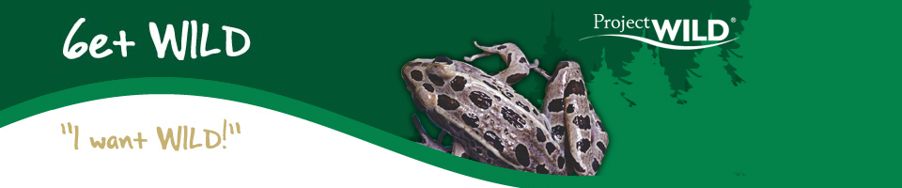


Slide 2

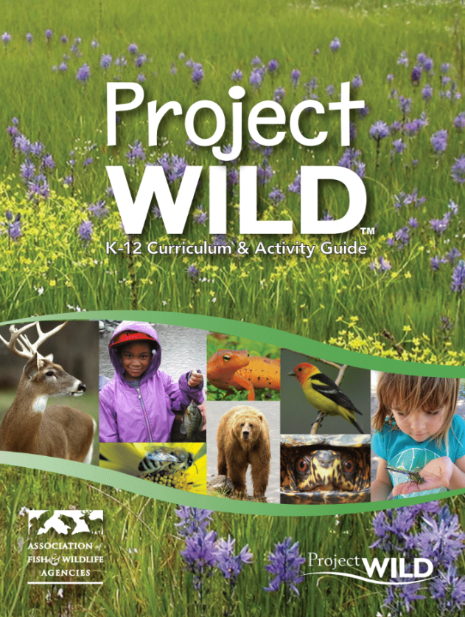
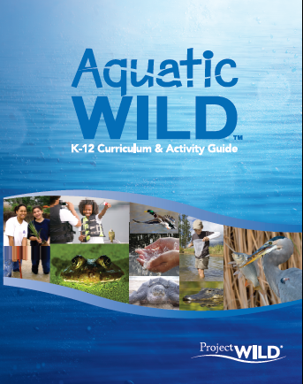

Project WILD and Aquatic WILD are interdisciplinary conservation and environmental education programs emphasizing wildlife.

Slide 3
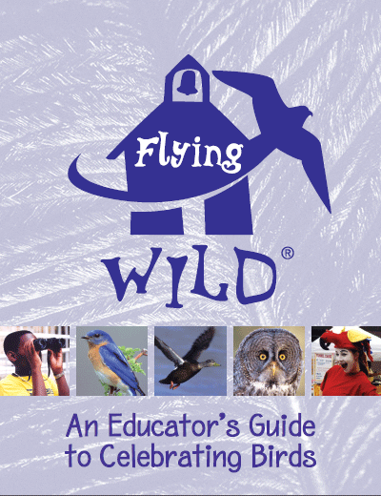
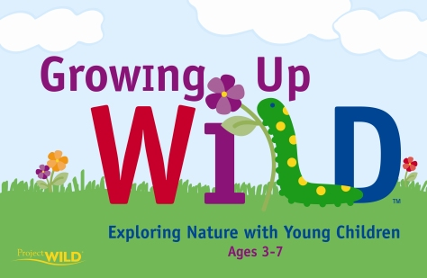
Project WILD Family of Programs

Slide 4

Project WILD is administered nationally by the
Association of Fish & Wildlife Agencies (AFWA)
Project WILD is sponsored throughout the United States, Puerto Rico, Canada, and Japan.

Slide 5
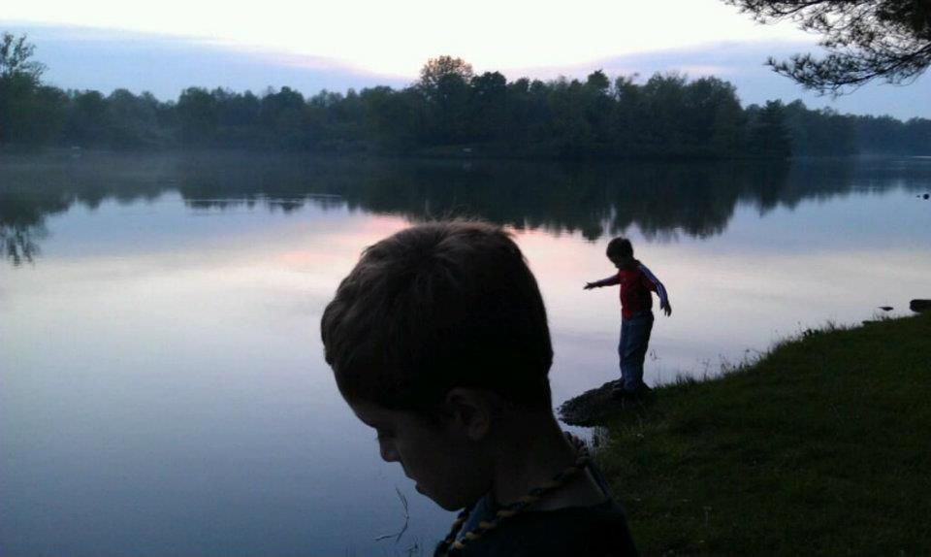
Project WILD Goal To assist students of any age in developing awareness, knowledge, skills, and commitment to result in informed decisions, responsible behavior, and constructive actions concerning wildlife and the environment.

Slide 6
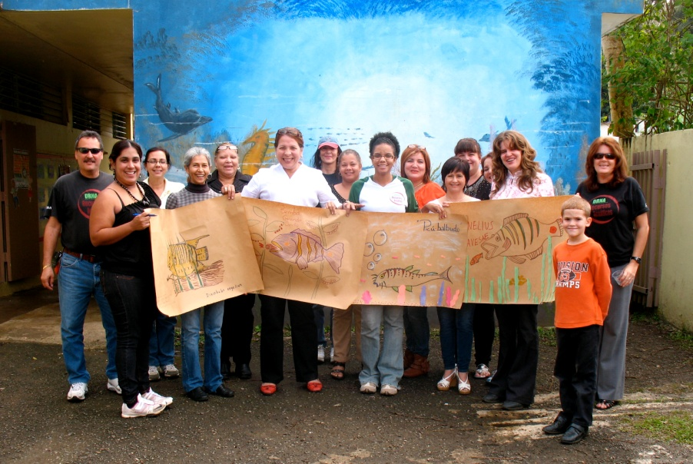
Project WILD Delivery Model
WILD, Aquatic, Flying WILD & Growing Up WILD: Available through professional development trainings conducted by certified facilitators
GUW & Flying WILD also available
Over 2 million educators trained
since WILD launched in 1983

Slide 7
Project WILD Family of Program Guides
Hands-on, interdisciplinary activities
Supports learning in formal & non-formal educational settings
Standards-based
Scientifically accurate materials
Pre-service educator training applications
Thorough development, field-testing, and evaluation protocol
Emphasis on outdoor learning and field investigations

Slide 8
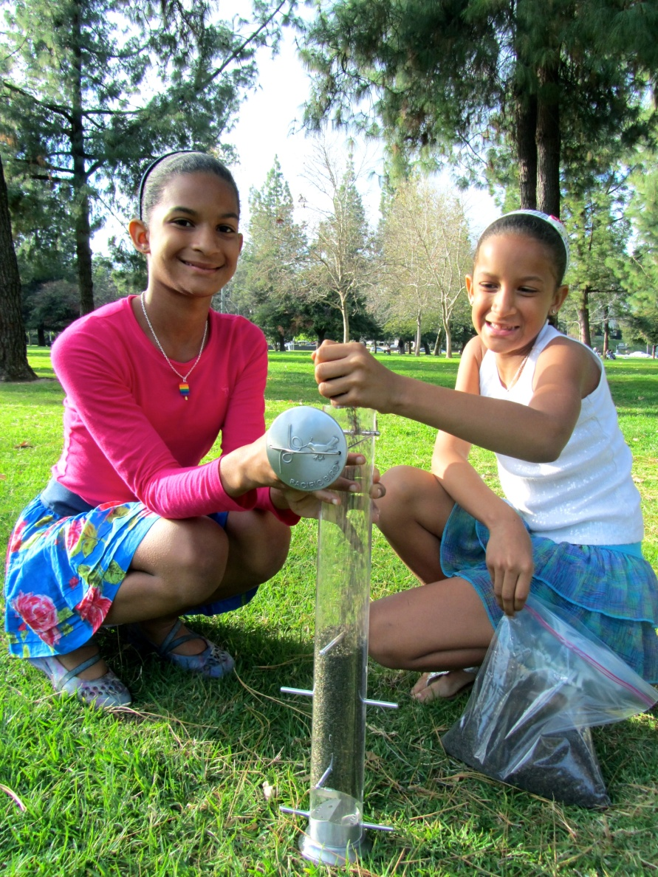
Project WILD Curriculum & Activity Guide
Activity Sections
Ecological Knowledge
  Develops a basis of understanding for the characteristics of environments and how they function.

Slide 9
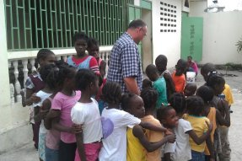
Project WILD Curriculum & Activity Guide
Activity Sections
2. Social and Political Knowledge
  Examines the way human cultures, economics, and politics have affected people’s attitudes toward natural resources.

Slide 10
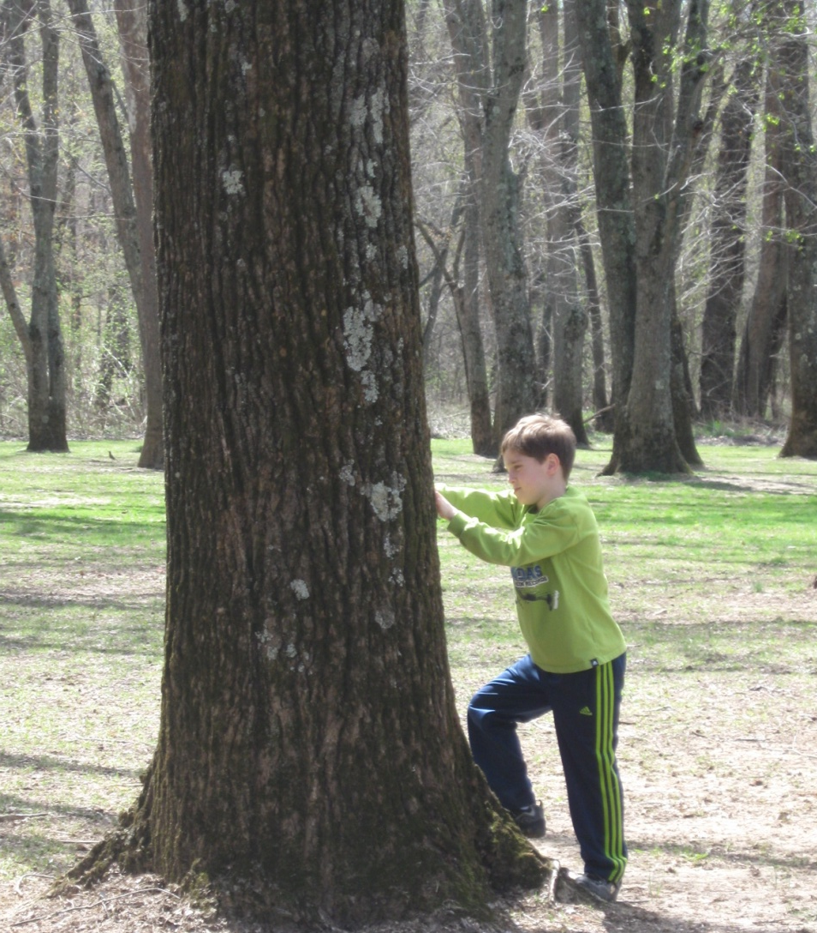
Project WILD Curriculum & Activity Guide
Activity Sections
3. Sustaining Fish & Wildlife Resources
  Encourages students to recognize, evaluate, and make responsible choices in their own lives regarding natural resources.

Slide 11
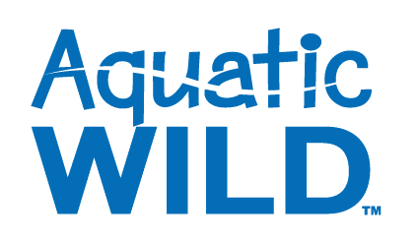
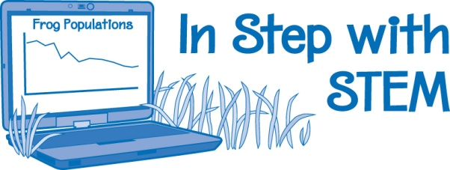
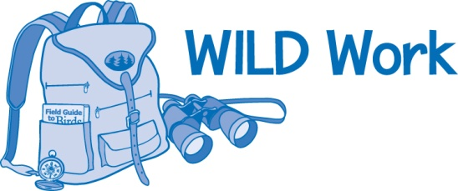
Extensions added to delve deeper into science, technology, engineering, and mathematics content. STEM extensions make use of a variety of tools from litmus tests to Smartphones and involve students in the application of technology, science, and math as part of their problem-solving efforts.
A career component added to all activities to tie in real occupations in the field of wildlife management and conservation with every lesson. Supplementary online resources to use with WILD Work are linked through an expanded WILD website.

Slide 12
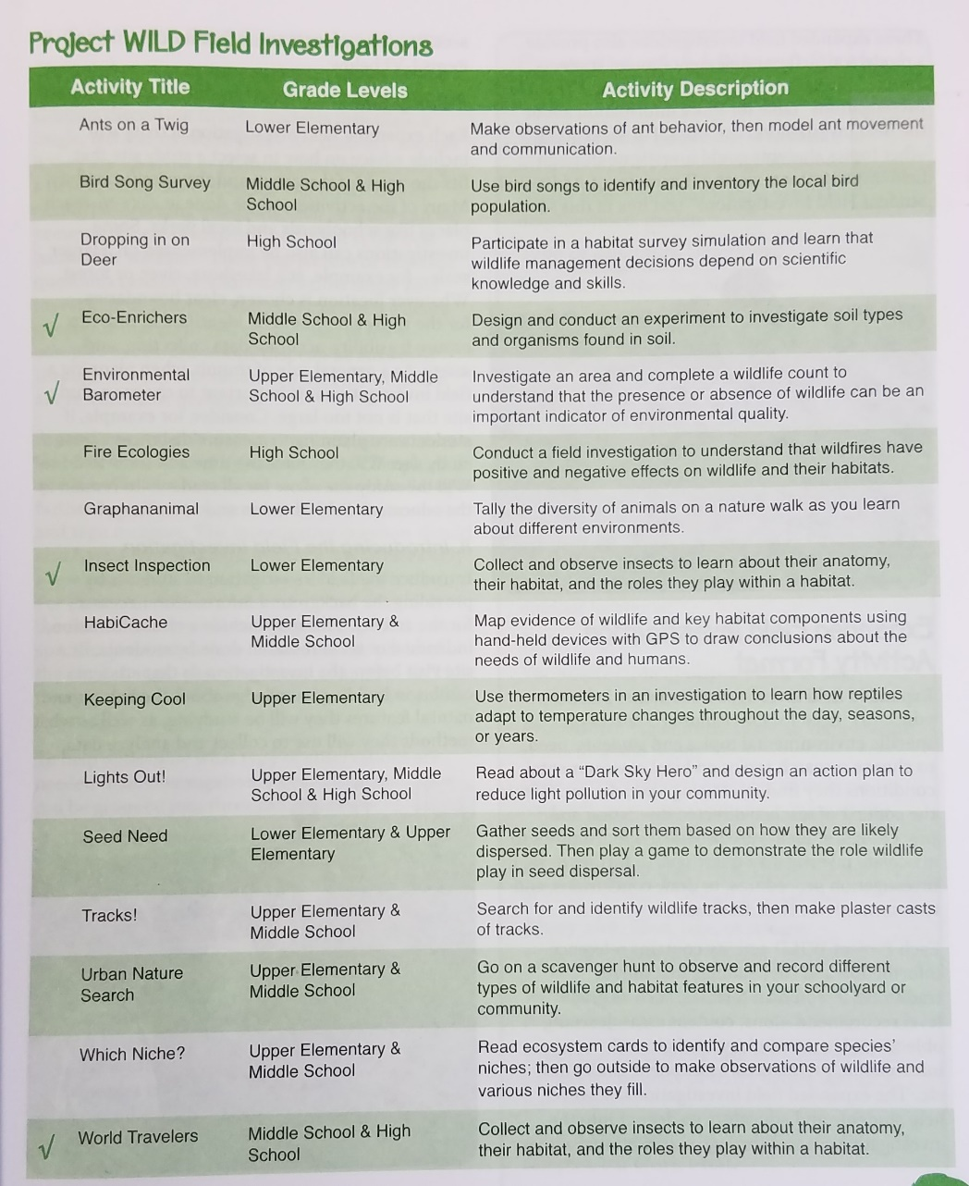
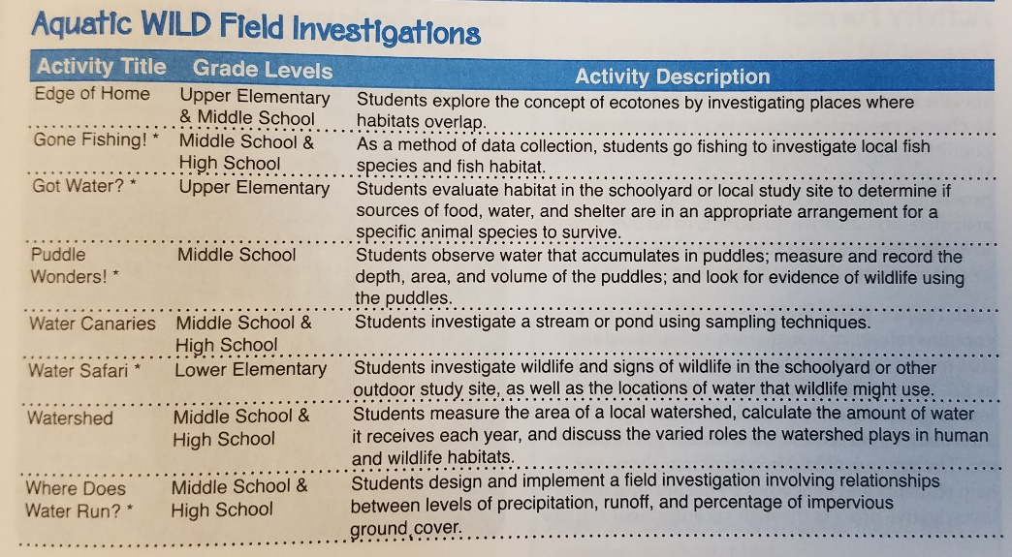
Field investigations
They teach students..
…how to conduct scientific inquiry.
…the importance of experimenting
in uncontrolled environments.
…how to think about systems.
…with firsthand experience.
…important STEM skills.
…in accordance with standards.

Slide 13
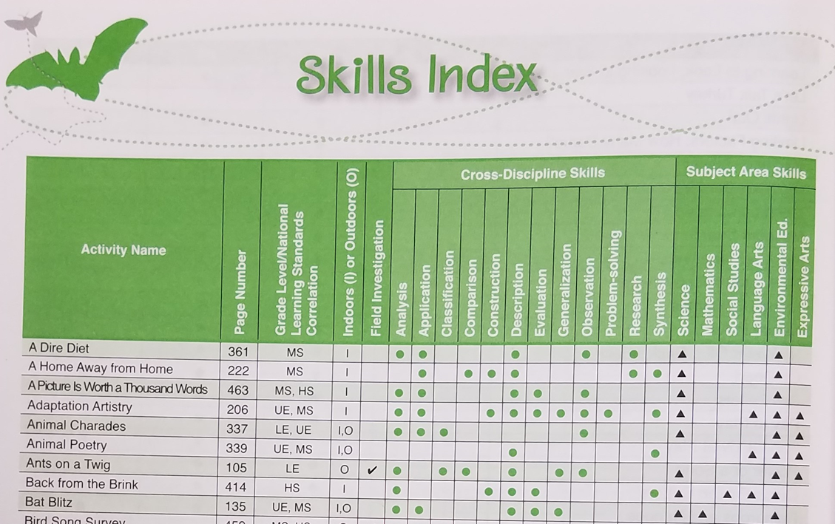
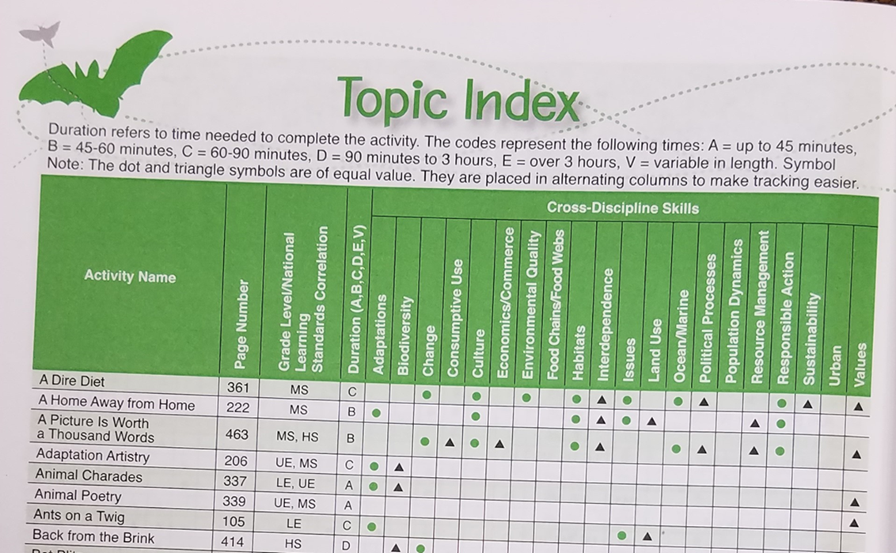
INDEXES - Grade, Skill, and Topic

Slide 14
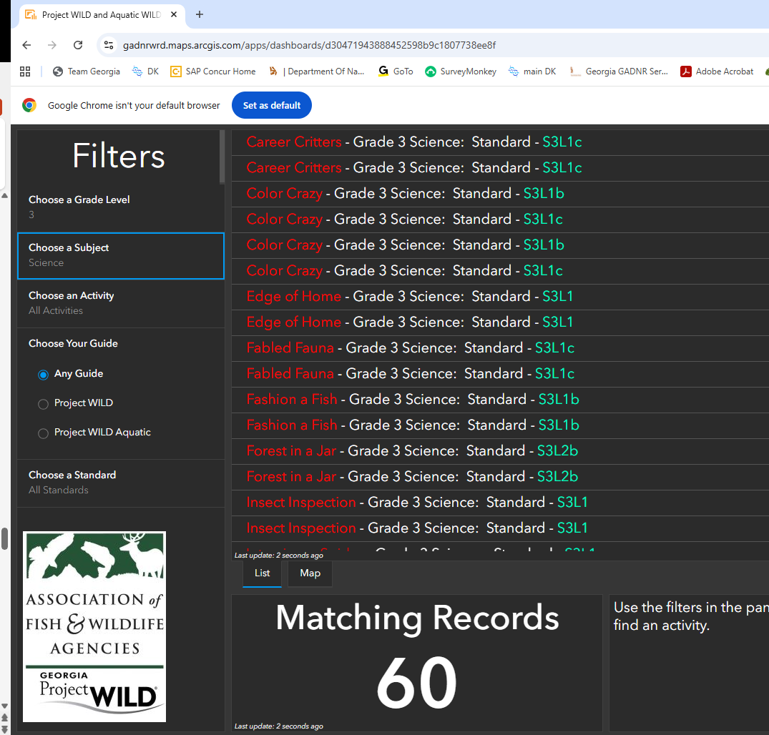
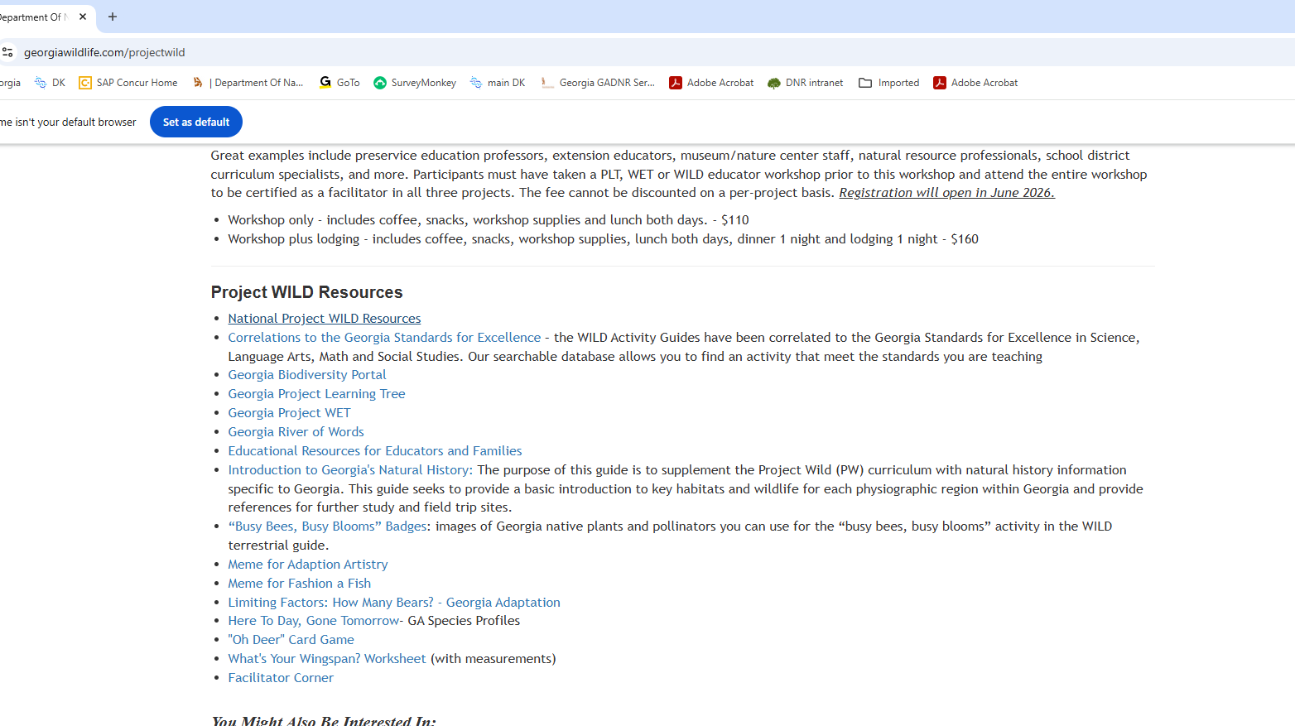


Alignment with Georgia Standards of Excellence
Science
Math
Language Arts
Social Studies
PE
Arts
Agriculture

Slide 15
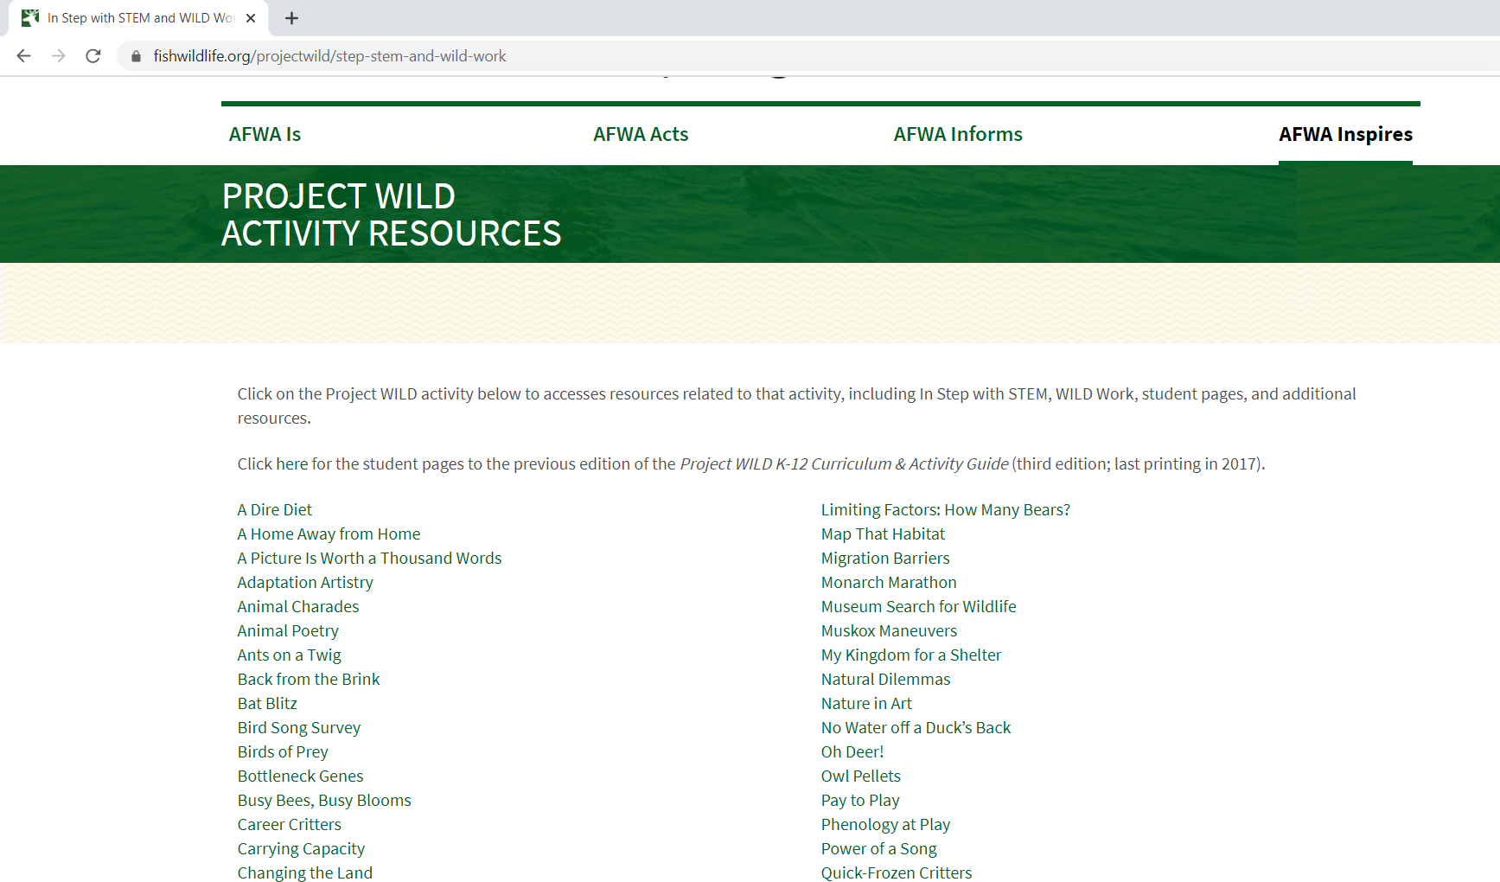
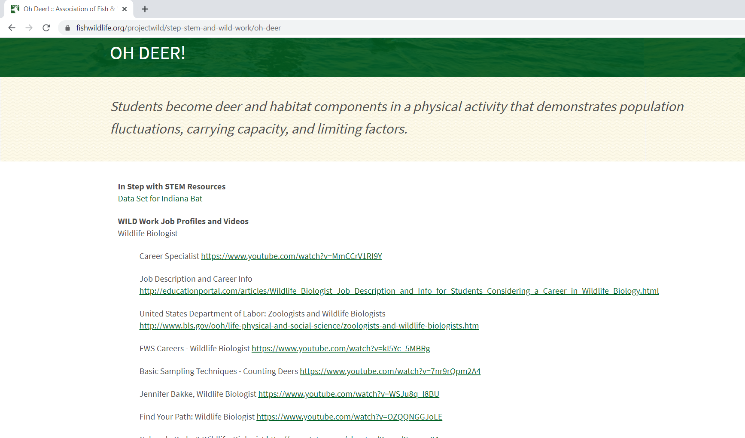
Web Resources
  Georgia Project WILD - https://georgiawildlife.com/projectwild
  Georgia Department of Natural Resources –
    Educator resources - https://georgiawildlife.com/educational-resources
    Wildlife - https://georgiawildlife.com/
  National Project WILD - https://www.fishwildlife.org/projectwild
New!

Slide 16
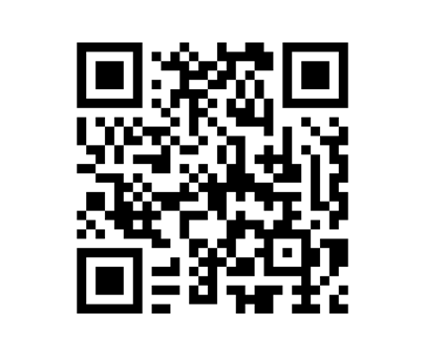
Workshop Evaluation
Thank you for joining us today and becoming a WILD one! Please click on the QR code or go to the link below to complete the Educator Workshop Evaluation
www.surveymonkey.com/r/53CBZP2

Slide 17
