Slide 1
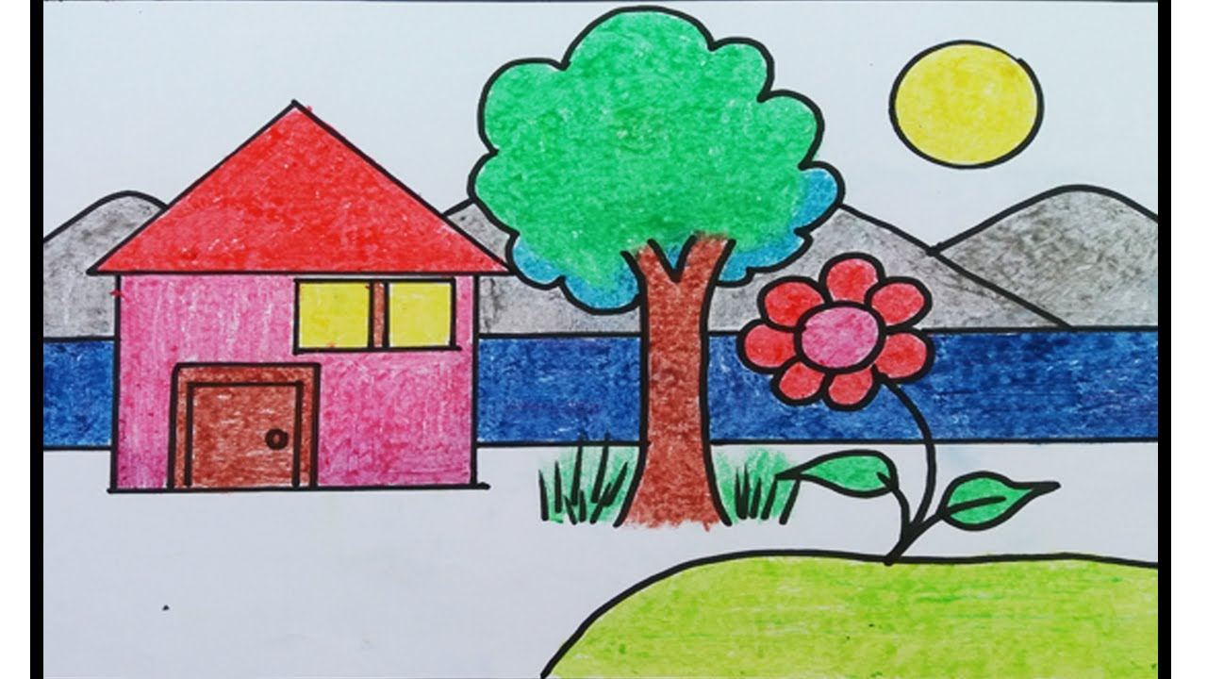
WELCOME!
Please go to the back and check and make sure your information is correct
Sign in on the sheet
  make sure you check the bottom for ethnicity
Make a name plate using the cardstock at your seat
Enjoy a nature iSpy game while you wait
Coffee and restrooms are in the back

Slide 2
First Impressions- GUW
Amber Barrow
Georgia Project WILD

Slide 3



Instructions
When you see an image of an animal, please walk over to the emoji that is the same as your first impression
Smile= Happy Feelings/Positive Feelings
Frown= Bad Feelings/Negative Feelings
Meh= Indifferent/ Not sure Feelings

Slide 4
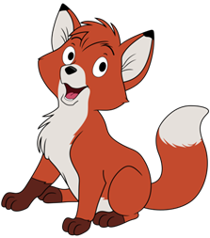

Slide 5
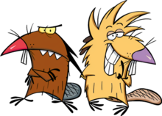

Slide 6


Slide 7
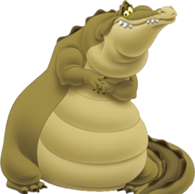

Slide 8
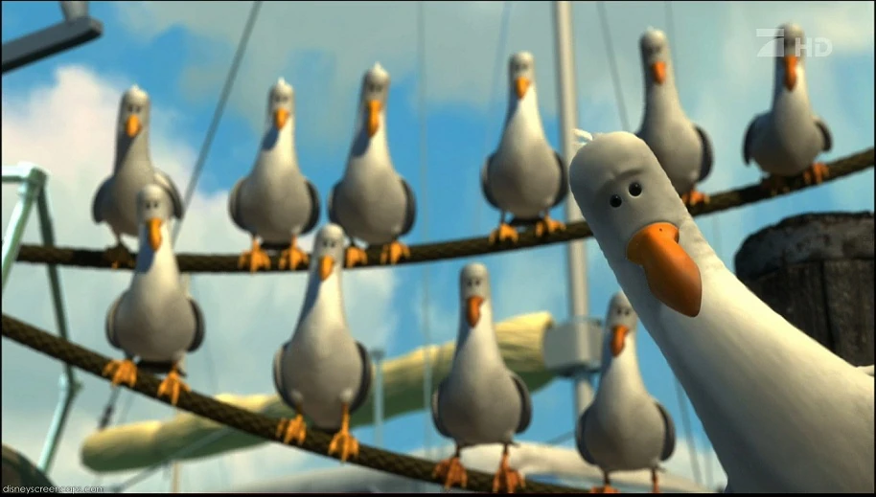

Slide 9
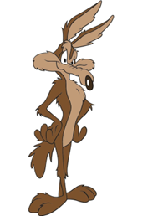

Slide 10
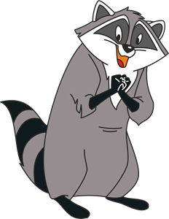

Slide 11
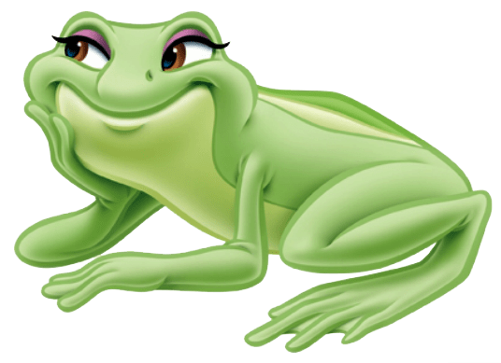

Slide 12
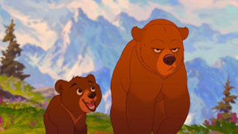

Slide 13
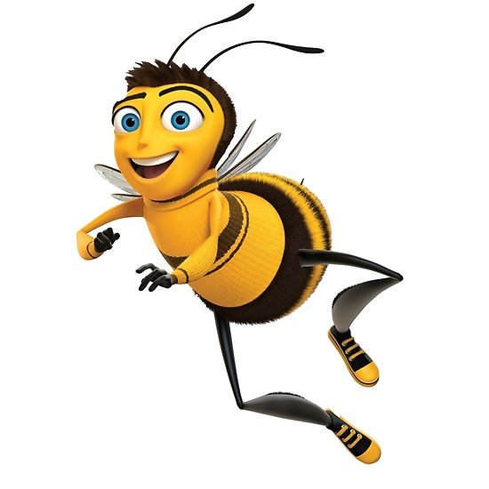

Slide 14
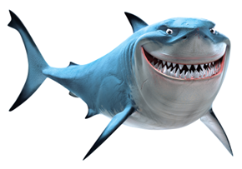

Slide 15
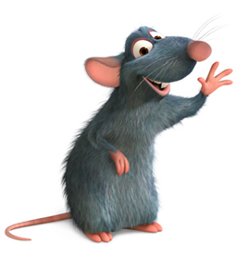

Slide 16
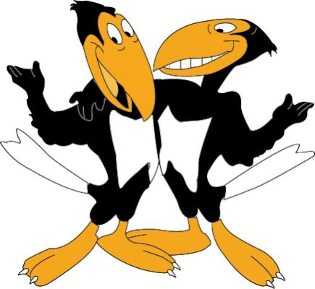

Slide 17
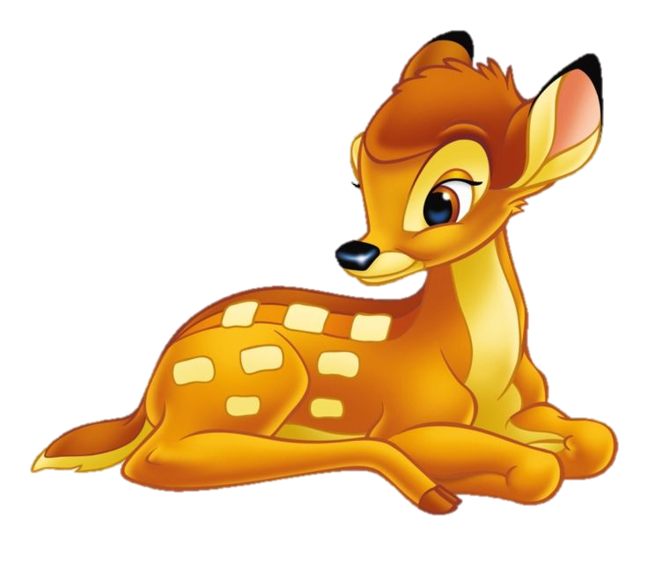

Slide 18
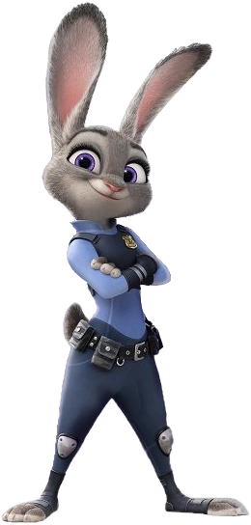

Slide 19
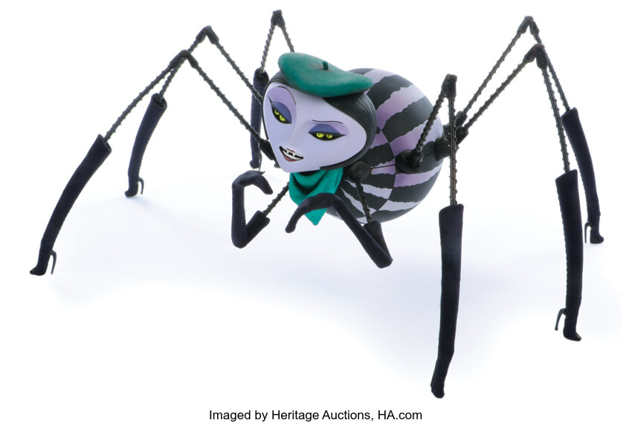

Slide 20
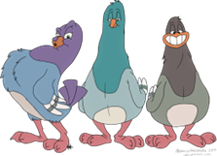

Slide 21
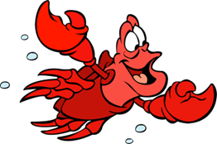

Slide 22
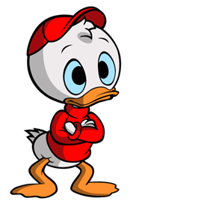
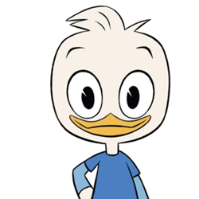

Slide 23
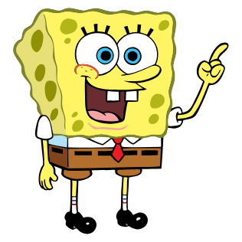

Slide 24
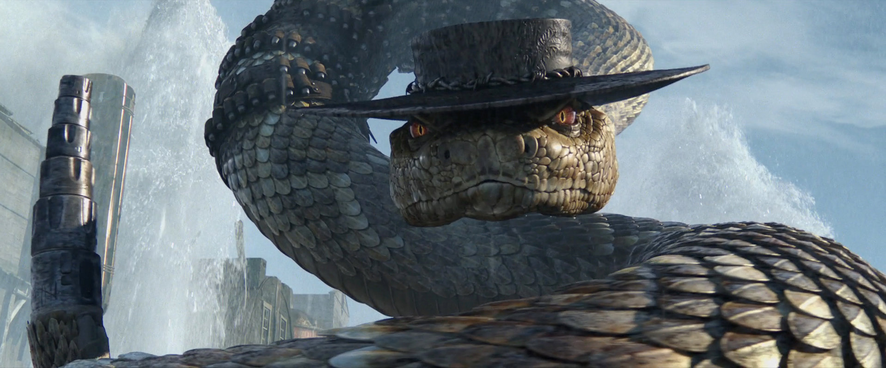

Slide 25
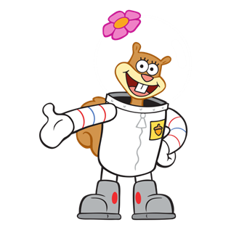

Slide 26
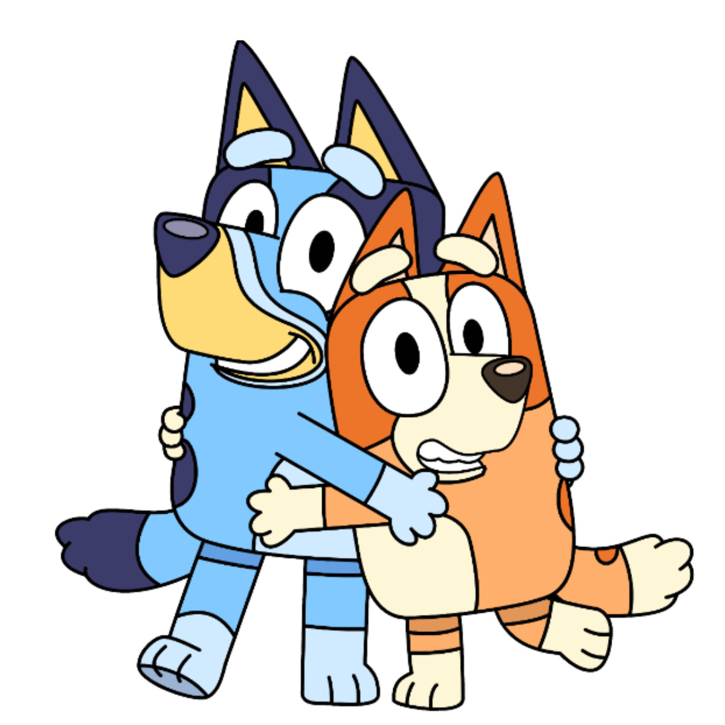

Slide 27
