Slide 1
Hike Through the Guide
Project WILD/Aquatic WILD

Slide 2
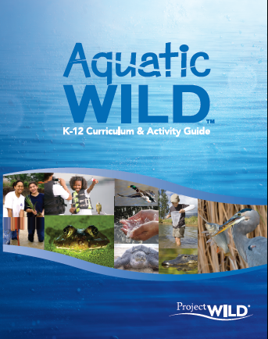
Question
1. List three divisions of the Project WILD Activity guide?

Slide 3
Answer
1. Ecological knowledge, social and political knowledge, and sustaining fish and wildlife resources

Slide 4
Question
2.Where can you find how to use Project WILD Field Investigations? How many FI are there?

Slide 5
Answer
2. On page xvii in the terrestrial guide, 16 total Field Investigations
On page xiv in the aquatic guide, 8 total field investigations

Slide 6
Question
3. How might you create a unit plan on the topic of changing land; changing climate for middle schoolers? What might be some activities and resources?

Slide 7
Answer
3. On page 520 terrestrial guide; activities listed

Slide 8
Question
4. What is hibernacula? What page was this information on?

Slide 9
Answer
4. In the Glossary, page 562 terrestrial guide; places where an animal hibernates or over winters

Slide 10
Question
5. Find an activity that is appropriate for lower elementary (LE) that uses description and evaluation. What is the name of the activity and what section of guide did you use to find it?

Slide 11
Answer
5. Skills index, pages 516-517 - Learning to Look, Learning to See, What bear Goes Where?

Slide 12
Question
6. Find an activity that is appropriate for grades 9-12 that addresses resource management. What is the name of the activity and what section of the guide did you use to find it?

Slide 13
Answer
6. Topic Index, pages 518-519; A Pictures Worth 1,000 Words, Back from the Brink, Bird Song Survey, Deer Dilemma, Dropping in on a Deer, Ecosystem Architects, Fire Ecology, Habitat Heros, Here today, Gone Tomorrow, Migration Barriers, Monarch Marathon, Pay to Play, Rain Drops and Ranges, The Power of Planning, Water Mileage, Wildlife and the Environment Community Survey

Slide 14
Question
7. What are the objectives to Lights Out?

Slide 15
Answer
7. On page 366 - Students will (1) define light pollution. (2) Describe the adverse effects of light pollution on wildlife. (3) Develop plans to reduce the adverse effects of artificial light.

Slide 16
Question
8. What is one Extension or variation in To Zone or Not to Zone?

Slide 17
Answer
8. On page 388 – (1) Have students identify a wildlife issue in their local area, gather data and conflicting opinions, and develop their own simulation. (2) Adapt this activity to a debate format. (3) Observe or participate in a local zoning board meeting. (4) Visit an outdoor site and observe various land use zones…..

Slide 18
Question
What content areas are covered in the activity “Alice in Waterland?”

Slide 19
Answer
9. On page 223 Aquatic WILD- Science Environmental Education, Mathematics, Social Studies, Expressive Arts

Slide 20
Question
10. What career(s) are addressed the aquatic WILD activity “Puddle Wonders?”

Slide 21
Answer
10. Page 171 WILD Work in the aquatic WILD guide- Field Biologists and Civil Engineers

Slide 22
Question
11. What are the STEM connections addressed in the activity “Water Safari?”

Slide 23
Answer
11. Page 40 aquatic WILD- Make simple graphs or pie charts that describe quantities of wildlife species identified.
Draw a map of the field site that includes the locations of water sources and where students observed animals or signs of wildlife
Discuss if human activities on the study site have affected water availability for wildlife.

