Slide 1
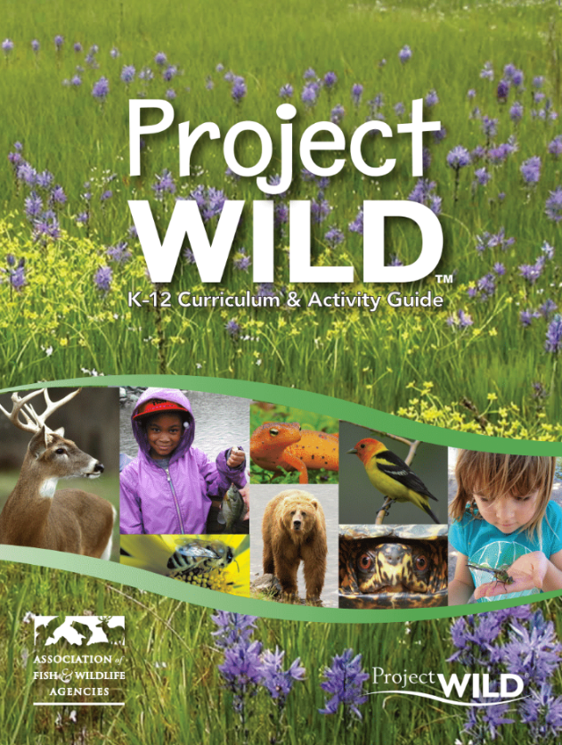
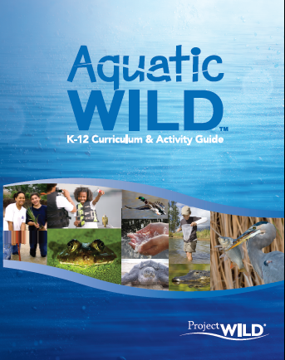
Project WILD and Aquatic WILD are interdisciplinary conservation and environmental education programs emphasizing wildlife.

Slide 2
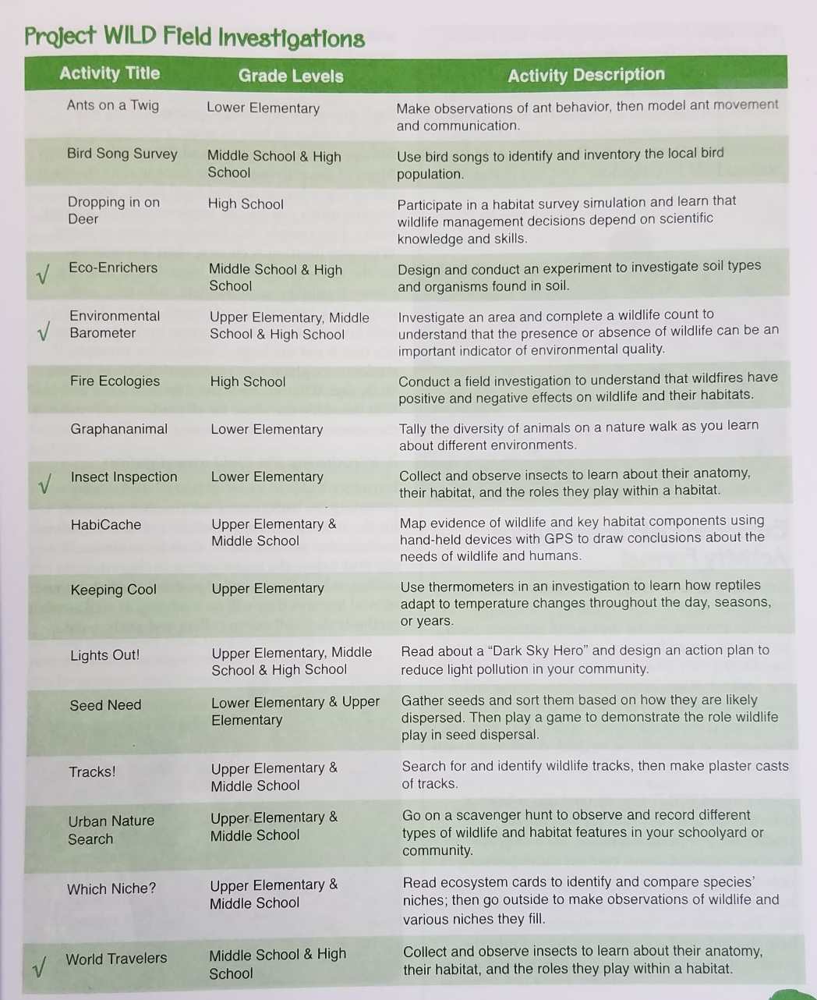
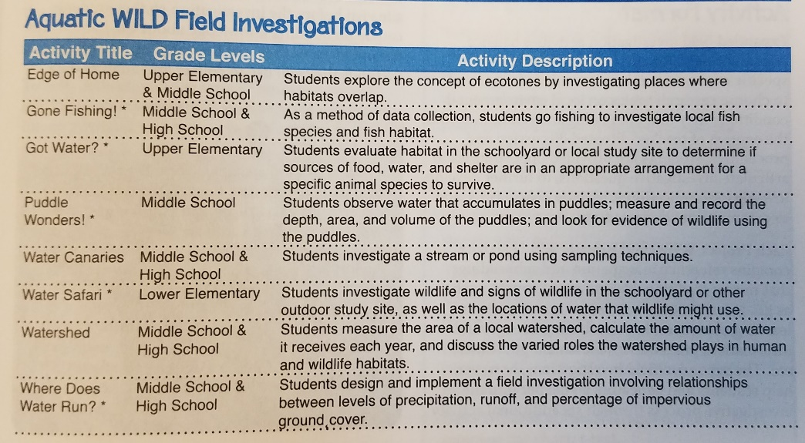
10 things to know about the guides
Field investigations
They teach students..
…how to conduct scientific inquiry.
…the importance of experimenting in uncontrolled environments.
…how to think about systems.
…with firsthand experience.
…important STEM skills.
…in accordance with standards.

Slide 3
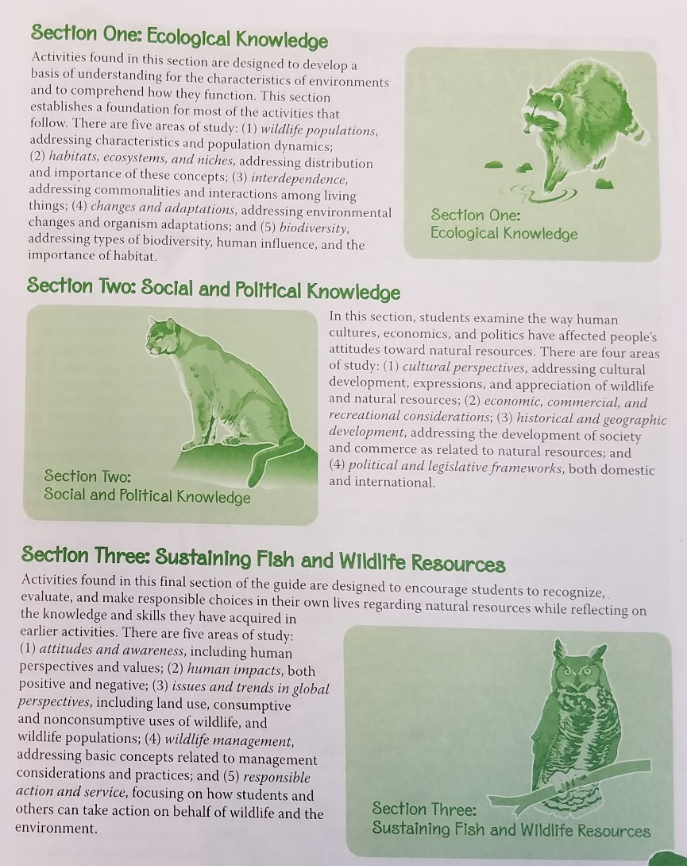
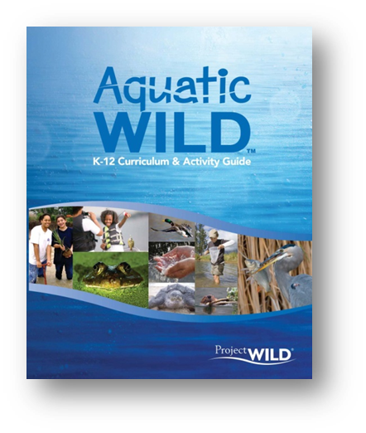
10 things to know about the guides
Organization of the guide

Slide 4
10 things to know about the guides
They are based on a Conceptual Framework
Ecological Knowledge
Wildlife Populations (WP)
Habitats, Ecosystems and Niches (HN)
Interdependence (ID)
Changes and Adaptations (CA)
Biodiversity (BD)
Social and Political Knowledge
Cultural Perspectives (CP)
Economic, Commercial & Recreation (EC)
Historical and Geographical Development (HD)
Political & Legislative Frameworks (PL)
Sustaining Fish & Wildlife Resources
Attitudes and Awareness (AA)
Human Impact (HI)
Issues and Trends (IT)
Wildlife Management (WM)
Responsible Action (RA)

Slide 5
10 things to know about the guides
Activity Format
User-friendly sidebar quickly identifies Grade, Subject, Duration, Group Size, Setting , Key Terms and more.
Objectives, Method, Materials outlined
Educator background section provides science content preparation and planning
Assessment section aligns with objectives
and procedures
Appendices identify activities by topic, subject, grade, skill, setting, and more

Slide 6
10 things to know about the guides
Extensions added to delve deeper into science, technology, engineering, and mathematics content. STEM extensions make use of a variety of tools from litmus tests to Smartphones and involve students in the application of technology, science, and math as part of their problem-solving efforts.
A career component added to all activities to tie in real occupations in the field of wildlife management and conservation with every lesson. Supplementary online resources to use with WILD Work are linked through an expanded WILD website.

Slide 7
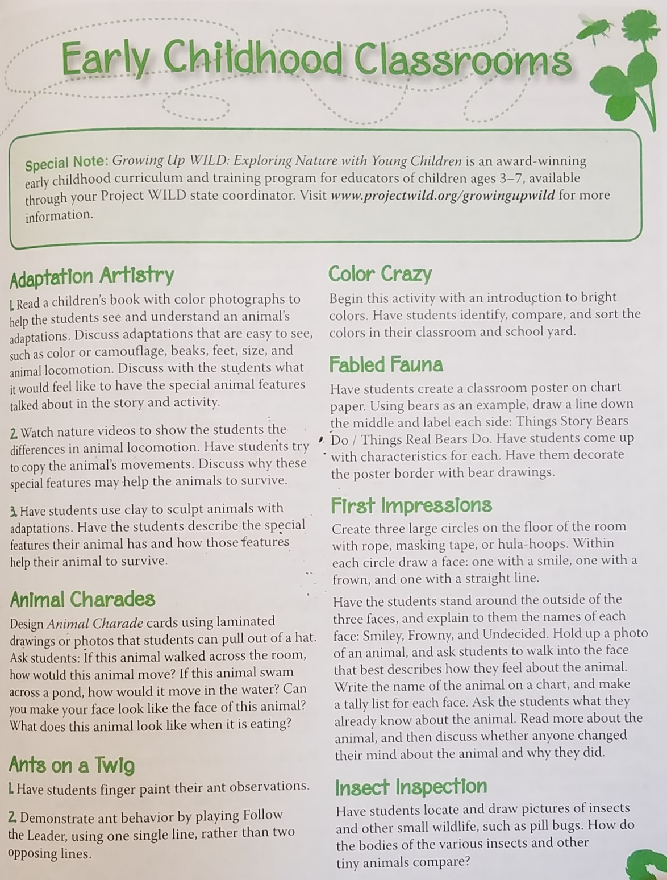
10 things to know about the guides

Slide 8
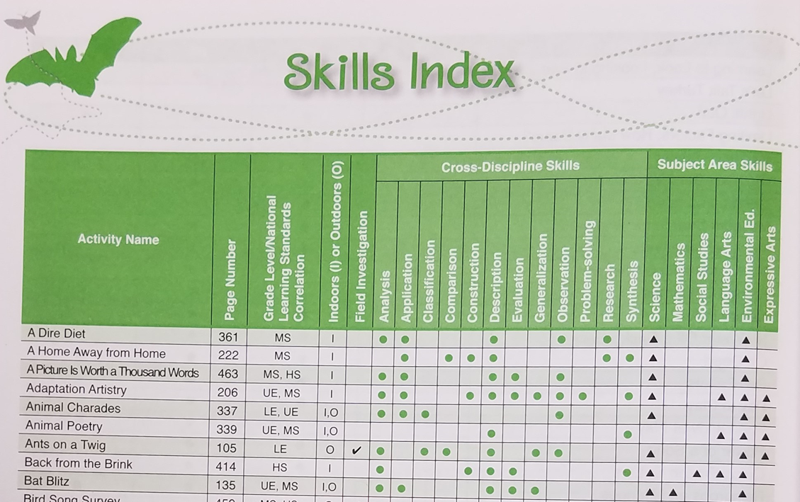
10 things to know about the guides
Index - Grade, Skill, Topic

Slide 9
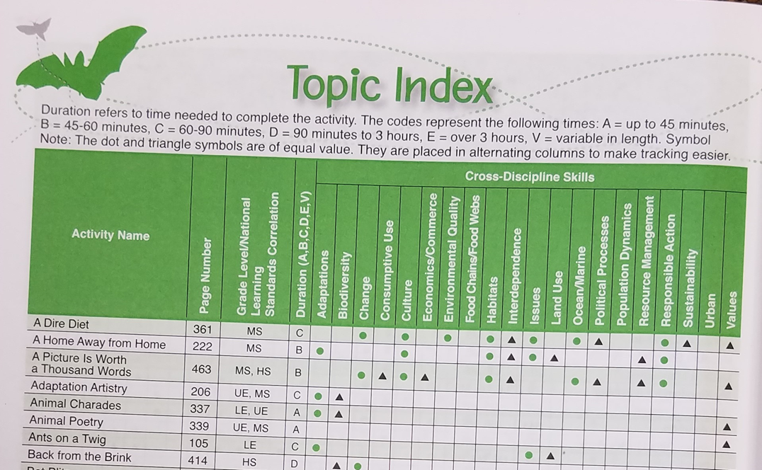

Slide 10
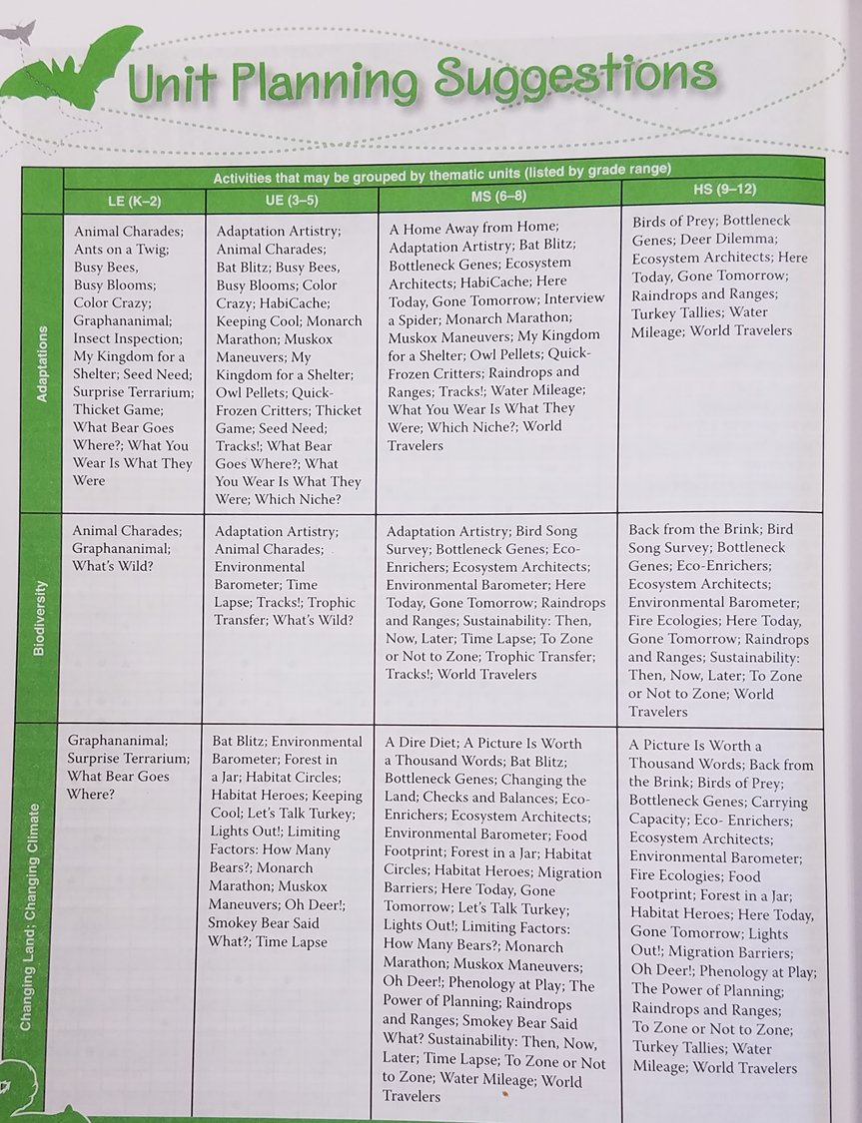
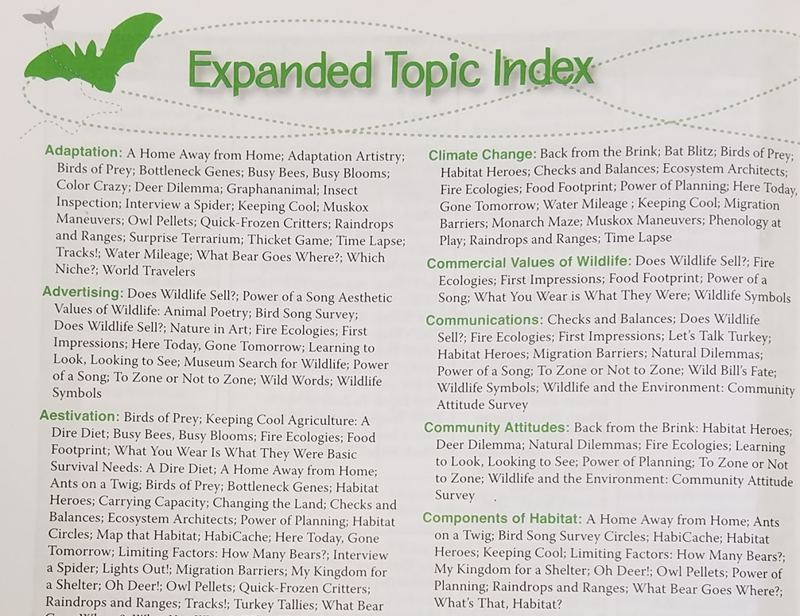
10 things to know about the guides

Slide 11
10 things to know about the guides
Field investigations
Organization of the guide
Conceptual Framework
Activity Format
WILD Work
In Step With STEM
Early Childhood Adaptations
Index - Grade, Skill, Topic
Unit Planning and Expanded Topic Index
Glossary

